Slide 1

www.espirity.com
Plug-in Development
Dwight Deugo (dwight@espirity.com)
Nesa Matic (nesa@espirity.com)
Notes:
Portions of the notes for this lecture include excerpts from the Eclipse 3.0 and 3.1 Help facility. These excerpts are made available under EPL for ease of use by instructors, (c) Copyright (c) 2000, 2005 IBM Corporation and others. For more complete information instructors are encouraged to read the full notes from the Eclipse Help facility.

Slide 2
Additional Contributors
None as of September, 2005

Slide 3
Module Overview
Extending Workbench
Notes:
In this module, we begin describing how to extend the Eclipse Workbench.

Slide 4
Module Road Map
Extending Workbench
  Contributing Actions
  Action set
  Adding toolbar and menu items to the Workbench
  Developing plug-in
  Installing plug-in
  Running plug-in
  Plug-in registry
Notes:
In this module, we begin describing how to extend the Eclipse Workbench and editors. This discussion includes how to add new menu items to the Workbench and editor menus and toolbars, and how to create, install, and run your new extensions. We also discuss how Eclipse keeps track of plug-in using the Plug-in registry.

Slide 5
Integration Between Plug-ins
Supported through ability to contribute actions to existing plug-ins
  New plug-in contributes an action to existing plug-in
  Allows for tight integration between plug-ins
There are many areas where actions can be contributed:
  Context menus of views and editors
  Local toolbar and pull-down menu of a view
  Toolbar and menu of an editor – appears on the Workbench when editor opens
  Main toolbar and menu for the Workbench
Notes:
Actions can be, in general, contributed to the editors and views. Views and editors can have actions contributed to their context menus, pull-down menus and tool bars.

Slide 6
Extending Views
Changes made to a view are specific to that view
Changes can be made to view’s:
  Context menu
  Menu and toolbar
Notes:
Changes can be made that are specific to a view, such as changes to its context menu, menu and toolbar.

Slide 7
Extending Editors
When extending an editor changes could be made to:
  Editor’s context menu
  Editor’s menu and toolbar
    The changes appear in the Workbench menu and toolbar only when editor opens
Actions defined are shared by all instances of the same editor type
  Editors stay open across multiple perspectives, so their actions stay same
  When new workspace is open, or workbench is open in a new window, new instance of editor can be created
Notes:
One feature of Eclipse is that Editors remain open across multiple perspectives. In fact, it is the same instance of the editor that is used by all perspectives.

Slide 8
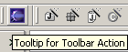
Action Set
Allows extension of the Workbench that is generic
  Should be used for adding non-editor, or non-view specific actions to the Workbench
  Actions defined are available for all views and editors
Allows customization of the Workbench that includes defining:
  Menus
  Menu items
  Toolbar items
Toolbar Action Set
Hover Help for the Toolbar Item
Notes:
The action set extension point is used to add menus, menu items and toolbar buttons to the common areas in the workbench window. These contributions are collectively known as an action set and appear within the workbench window by user preference.

Slide 9
Choosing What to Extend
Eclipse has a set of predefined extension points
  Called Platform Extension Points
    Comprehensive set of extension points
    Detailed in the on-line help
It is possible to create new extension points
  Requires id, name, and schema to be defined
  Done through Plug-in Development Environment (PDE)
Notes:
When defining new extension points, a point id, name and schema must be defined. The id is unique identifier that other plug-ins using the extension point will refer to, and schema is an XML schema that contains validation rules for the extension point. We will look into defining new extension points in details later.

Slide 10
Some Common Extension Points
Popup Menus for editors and views
  org.eclipse.ui.popupMenus
Menu and toolbar for views
  org.eclipse.ui.viewActions
Menu and toolbars for editors
  org.eclipse.ui.editorActions
Menu and toolbar for the Workbench
  org.eclipse.ui.actionSets
Complete set of extension points located in Eclipse help, including definitions
  Search on “Platform Extension Points”
Notes:
To find documentation about extension points, check out Eclipse’s help facility. If you wish, go directly to a plug-in directory and by convention any documentation will be located in its “doc” directory.

Slide 11
How to Extend the Workbench?
Steps for adding a plug-in:
  Write the plug-in code
    Define Java project
    Create Java class
    Add appropriate protocols to the class
  Package the class
  Create plugin.xml and manifest.mf
  Test the plug-in
  Deploy the plug-in
Notes:
The steps above are generic steps for creating Eclipse plug-in.
We will extend the workbench with toolbar and menu items. The Java code for the plug-in will simply do nothing, but the class that handles click on menu item or toolbar item must be defined.

Slide 12
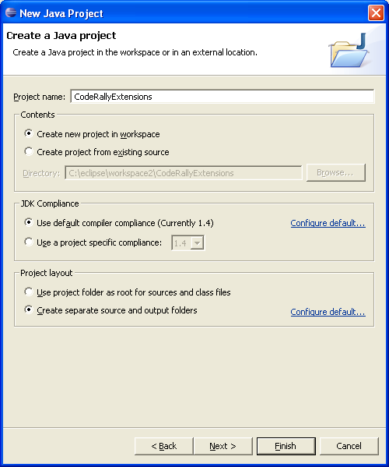
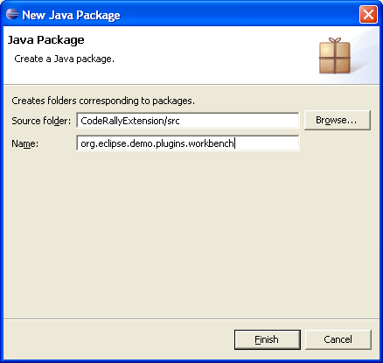
Creating Java Project
Project will contain source code for the plug-in
Classes will be defined in the package:
  org.eclipse.demo.plugins.workbench
Notes:
Always remember to choose good project names. In addition, think hard about your package naming. Since the convention is to use a directory name that mimics your package structure, e.g., org.apache.ant_1.5.3, you should name your packages accordingly.

Slide 13
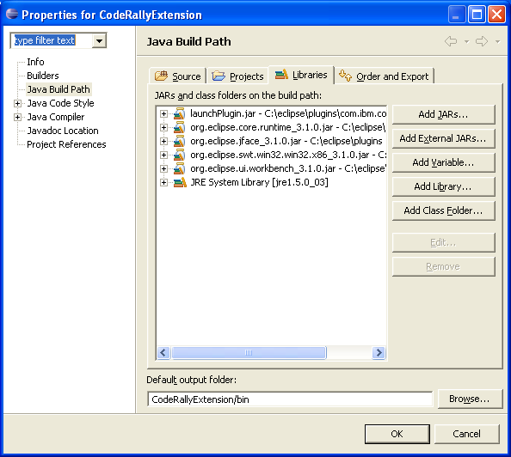
Updating Project’s Build Path
To make classes required for the plug-in visible for the project, update its path
  jFace.jar, swt.jar runtime, and workbench.jar files must be added to project’s build path
Notes:
If your plug-in requires other plug-in, make sure to update your project’s build path. Make sure to add the following:
The jFace.jar is in c:\....\eclipse\plugins\org.eclipse.jface_3.0.0
The source is in c:\...\eclipse\plugins\org.eclipse.platform.source_3.0.0\src\org.eclipse.jface_3.0.0\jfacesrc.zip.
The swt.jar file is in c:\....\eclipse\plugins\org.eclipse.swt.win32_3.0.0\ws\win32
The source is in c:\....\eclipse/plugins/org.eclipse.platform.win32.source_3.0.0/src/org.eclipse.swt.win32_3.0.0/ws/win32/swtsrc.zip
The workbench.jar file is in c:\....\eclipse\plugins\org.eclipse.ui.workbench_3.0.0.
The source is in c:\....\eclipse\plugins\org.eclipse.platform.source_3.0.0\src\org.eclipse.ui.workbench_3.0.0.0\workbenchsrc.zip

Slide 14
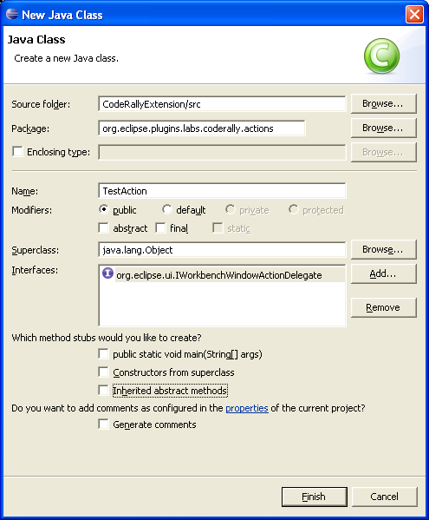
Creating a Class
For menu actions, define a class that:
  Subclasses client delegate class
  Implements interface that contributes action to the Workbench
Notes:
When creating class that will handle actions, i.e. that will participate in the action delegation, it is important to know which class it should inherit from and which interfaces it should implement.
In our example we are creating action delegate class for participating in the change of the Workbenches toolbar and menu.
When changing the toolbar it is possible to add a pull-down menu to the toolbar item. In this case the action class would need to implement IWorkbenchWindowPulldownDelegate interface instead of IWorkbenchWindowActionDelegate interface.

Slide 15
Interface IWorkbenchWindowActionDelegate
Extend IActionDelegate and define methods:
  init(IWorkbechWindow) – Initialization method that connects action delegate to the workbench window
  dispose() - Disposes action delegate, the implementer should unhook any references to itself so that garbage collection can occur
Interface is for an action that is contributed into the workbench window menu or tool bar
Notes:
Implementers of the interface can use selectionChanged() method to change the availability of the action or to modify other presentation properties. When the selection changes, the action enablement state is updated based on the criteria specified in the plugin.xml file. Then the delegate is notified of the selection change regardless of whether the enablement criteria in the plugin.xml file is met.

Slide 16
Class ActionDelegate
Abstract base implementation for a client delegate action (defines same methods as interface)
In addition it also defines:
  runWithEvent(IAction, Event)
    Does the actual work when action is triggered
    Parameters represent the action proxy that handles the presentation portion of the action and the SWT event which triggered this action being run
    Default implementation redirects to run() method
  run(IAction)
    Inherited method, does the actual work as it’s called when action is triggered
  selectionChanged(IAction, ISelection)
    Inherited method, notifies action delegate that the selection in the workbench has changed

Slide 17
Action Delegate Code
public class MyFirstActionDelegate extends ActionDelegate implements IWorkbenchWindowActionDelegate{
IWorkbenchWindow activeWindow = null;
public void run(IAction action){
// used for defining what is done when action executes
System.out.println("Hello from the action delegate run() method!");
}
public void selectionChanged(IAction proxyAction, ISelection selection){
// used if action is dependent on the selection
}
public void init(IWorkbenchWindow window){
// used for initialization
activeWindow = window;
}
Notes:
run() method defines what will be executed when action runs. In the above example when action runs an output will be printed to the standard Java output.
selectionChanged() method is used when action depends on a selection.
init() method is used for initialization and in the example above you can see activeWindow field of the action delegate set to the passed window parameter, which represents current workbench window. This window can be used for opening dialogs, other views, etc. when executing the action.

Slide 18
Defining Manifest
Manifest.mf file
Located in the META-INF directory
Manifest-Version: 1.0
Bundle-ManifestVersion: 2
Bundle-Name: Code Rally Extension
Bundle-SymbolicName: org.eclipse.plugins.labs.coderally; singleton:=true
Bundle-Version: 1.0.0
Bundle-Vendor: Espirity
Bundle-Localization: plugin
Require-Bundle: com.ibm.coderally,
org.eclipse.ui.workbench,
org.eclipse.swt,
org.eclipse.jface,
org.eclipse.ui
Eclipse-AutoStart: true
Plug-in specifics
Other plug-ins required by the plug-in
Notes:
There are many ids used in a manifest file. Individual extension points often define configuration parameters that require ids (such as the category id used above for the views extension point). We also define a plug-in id. In general, you should use Java package name prefixes for all of your ids in order to ensure uniqueness among all the installed plug-ins.
The specific name that you use after the prefix is completely up to you. However, if your plug-in id prefix is exactly the same name as one of your packages, you should avoid using class names from that package. Otherwise it will become difficult to tell whether you are looking at an id name or a class name.
You should also avoid using the same id for different extension configuration parameters. In the above manifest, we have used a common id prefix (org.eclipse.examples.helloworld) but all of our ids are unique. This naming approach helps us to read the file and see which ids are related.
Required plug-ins are plug-ins that are not part of the feature but must be present in the target platform as a prerequisite for installing the feature. If any of these plug-ins are missing, the feature will not be installed.

Slide 19
Defining plugin.xml…
Extension point for action set
Label that will appear in Preferences window
<?xml version="1.0" encoding="UTF-8"?>
<?eclipse version="3.0"?>
<plugin>
<extension
point="org.eclipse.ui.actionSets">
<actionSet
label="Espirity Action Set"
visible="true"
id="com.espirity.course.plugins.actionSet">
<menu
label="Espirity Menu"
id="espirityMenu">
<separator name="EspirityGroup"/>
</menu>
… more on next page
Notes:
The attribute visible=“false” indicates that the toolbar item will not be visible by default for all perspectives, but that will have to be made visible for a particular perspective by customizing it.
If icon attribute is not available or if actual icon is not available, label will be shown instead in the Workbench.
The tooltip attribute indicates what text will show up in the hover help for the toolbar item.

Slide 20
…Defining plugin.xml…
<action
label="Espirity Test Action"
icon="icons/espirity.jpg"
class="org.eclipse.plugins.labs.coderally.actions.TestAction"
tooltip="Espirity Test Tooltip"
menubarPath="espirityMenu/EspirityGroup"
toolbarPath="EspirityGroup"
id=" org.eclipse.plugins.labs.coderally.actions.TestAction">
</action>
</actionSet>
</extension>
</plugin>
Icon that will appear in the toolbar
Class that will handle action

Slide 21
…Defining plugin.xml
Pre OSGI/Manifest.mf
The library element can specify which portion of the library should be exported. By default the library is considered to be private.
If you plan to make your plug-in’s library (e.g., launchPlugin.jar) classes available for others to use, update your plugin.xml file with the following:
    <runtime>
    <library name="launchPlugin.jar">
    <export name="*"/>
    </library>
    </runtime>

Slide 22
Testing Plug-in from the Workbench
Available through opening new Workbench instance by choosing
  Run → Run As → Eclipse Application
Used when developing plug-in with-in the platform
  Mostly used for the plug-in development
Project’s output folder must be /bin/ directory
  For example MyFirstPluginProject/bin
  Can be set in project’s properties window
Notes:
If for some reason the runtime Workbench doesn’t work properly, and it won’t start up properly again, you can look at the runtime-workspace directory of the Eclipse install directory. This directory contains meta-data that is used for starting another instance of the Workbench. For example, the log file will provide info for the missing classes, missing plug-ins, etc. To force the platform to create new version of the meta-data, you can simply delete everything under the runtime-workspace directory and restart the new instance of the Workbench.

Slide 23
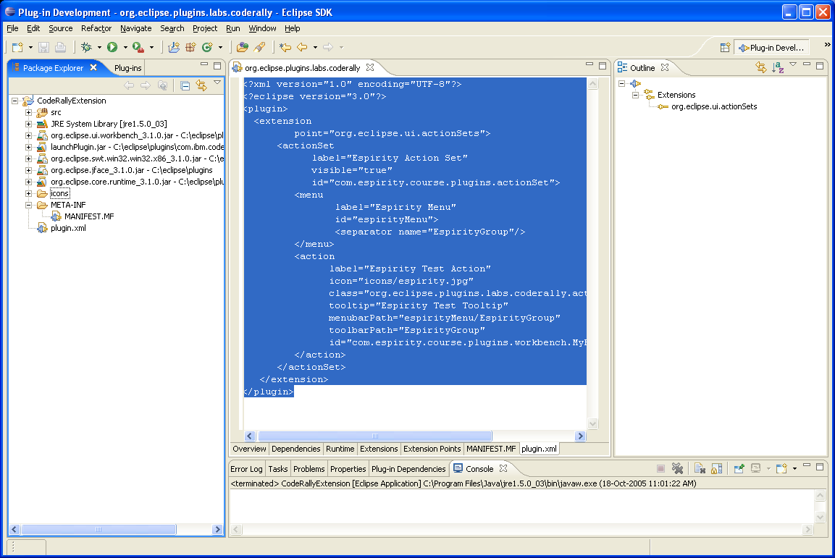
Testing Requirements
Plug-in manifest file and all other resources required by the plug-in must be part of the project
Required by
the plug-in
Notes:
If you use plug-in development environment and plug-in wizards for developing plug-ins, all required resources automatically become part of the project. They include required jar files, plug-in manifest file and all other resources specified by selections and inputs in wizards.

Slide 24
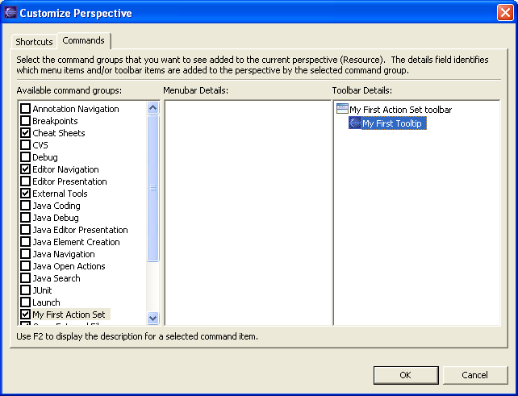
Setting the Perspective
Eclipse must be restarted (runtime workspace) to pick up new plug-in that we have defined
Customize opened perspective to show plug-in
Notes:
This step must be done because visible attribute in the plug-in manifest file was set to false. If this attribute was true, than the plug-in would be visible in all perspectives without explicitly customizing any perspective.

Slide 25
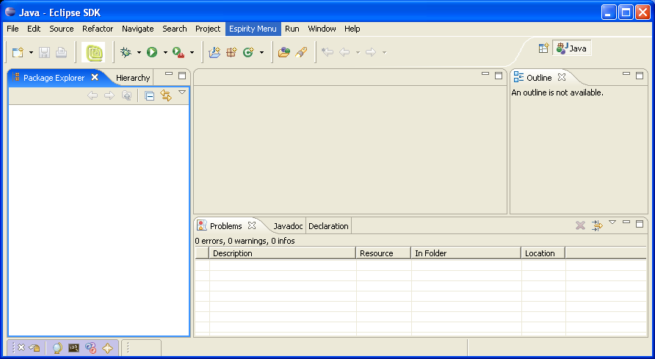
Running the Plug-in
Added toolbar item
Added menubar item
Notes:
Click on the toolbar icon will cause the code defined in the action’s class to execute. Our class prints “Hello from the action delegate run() method!” text to the Console.

Slide 26
Getting Ready to Export Plug-in
Create a build.properties file in your project with the following contents:
source.. = src/
output.. = bin/
bin.includes = plugin.xml,\
META-INF/,\
.,\
icons/

Slide 27
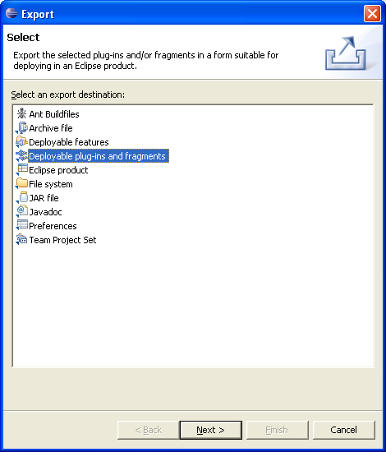
Export Deployable Plug-ins and Fragments…

Slide 28
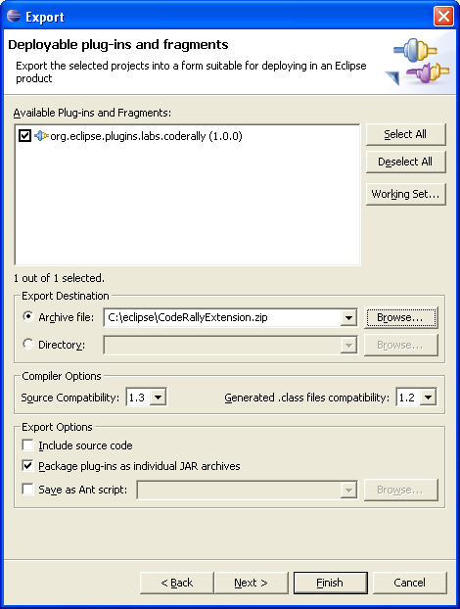
…Export Deployable Plug-ins and Fragments
Export the code as a Archive file
The plug-in will have a zip extension
Your plug-in is in the zip file and has the jar extension
Notes:
Every plug-in has its unique identifier. Our plug-in will be installed in the directory com.espirity.course.plugins.workbench located under plugins directory of the Eclipse. This directory must be unique and that’s the reason why it follows Java packaging naming convention.

Slide 29
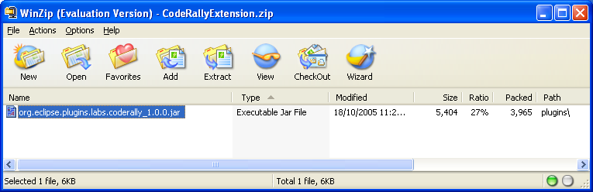
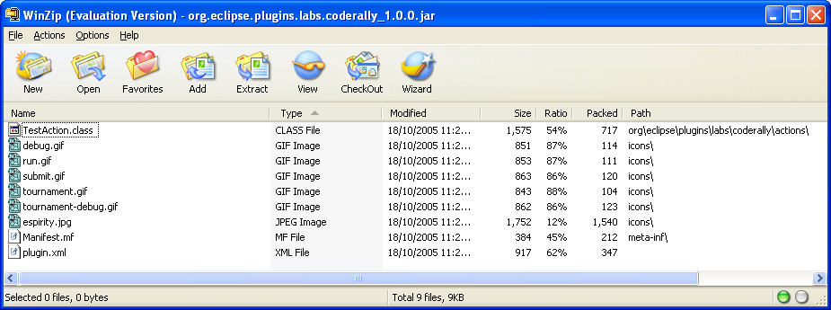
Plug-in ZIP and JAR files
The Plug-in ZIP file has:
  Your Plug-in’s JAR file
Unzip contents into plugins directory

Slide 30
Installing Plug-in
Make sure the new plug-in.jar file is in Eclipse’s plugin directory.
Restart Eclipse
Warning
  Try your new plug-in in a fresh/non-development Eclipse install
  You don’t want to have problems in your development install

Slide 31
Adding Submenu
…
<menu
id="my_actions.menu"
label="My First Menu"
path="additions">
<separator name="menu_group"/>
</menu>
<menu
id="my_actions.submenu"
label="My First Submenu"
path="my_actions.menu/menu_group">
<separator name="submenu_group"/>
</menu>
…
1
2
Text that will appear in the submenu
Indicator where menu will be placed
1
+ "/" +
2

Slide 32
Adding Action to the Menu
…
<menu
id="my_actions.menu"
label="My First Menu"
path="additions">
<separator name="menu_group"/>
</menu>
<menu
id="my_actions.submenu"
label="My First Submenu"
path="my_actions.menu/menu_group">
<separator name="submenu_group"/>
</menu>
<action
id="my_actions.menu.action"
label="My First Submenu Action"
icon="icons/eclipse.gif"
tooltip="My First Submenu Action Tooltip" menubarPath="my_actions.menu/my_actions.submenu/submenu_group"
class="com.espirity.course.plugins.workbench.MyFirstMenuActionDelegate">
</action>
…
Action menu bar path includes menu id + submenu id + submenu group
Notes:
The action definition for menu is similar to the action definition for the toolbar. An action delegate class would need to be defined for handling triggering of the action.

Slide 33
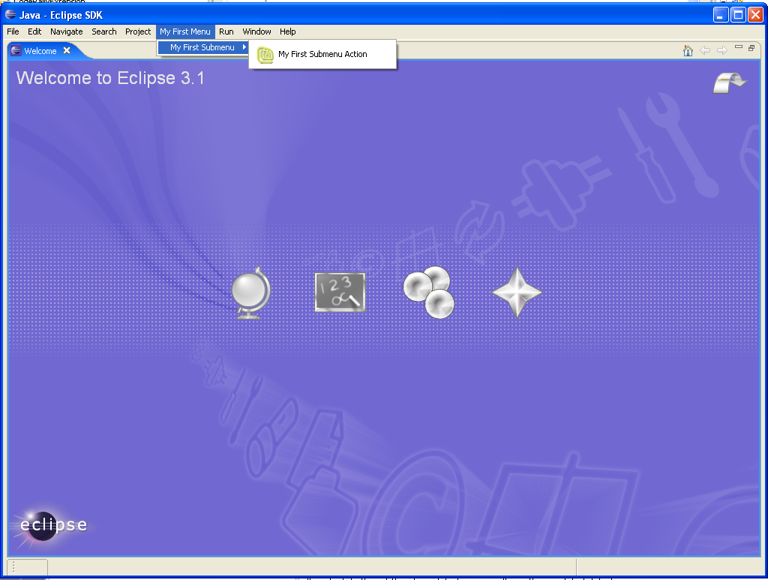
Workbench Changes
Added top level menu
Added action
Notes:
After restarting Eclipse, changes made will show in the Workbench.

Slide 34
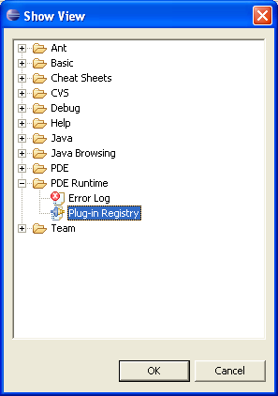
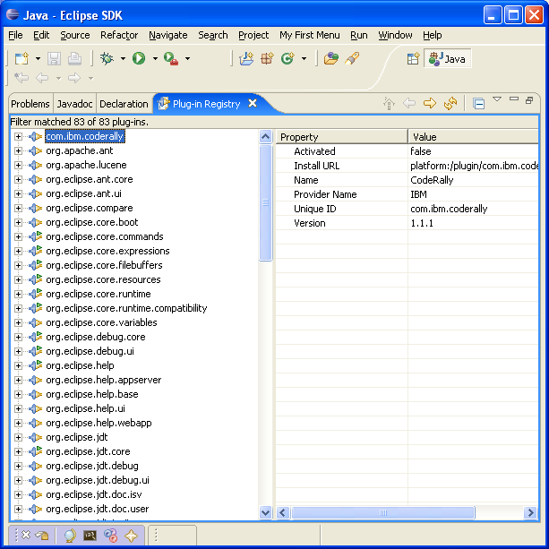
Plug-in Registry
To see what plug-ins are registered within the Workbench select:
  Window → Show View → Other…
Notes:
It is possible to view registered and available plug-ins. The Plug-in Registry view displays details about plug-ins. This view can be useful in the run-time workbench instance to see whether your plug-in has been started and what plug-in artifacts (extensions, extension points, libraries, etc.) are recognized by the platform. Detailed properties of the selected objects in the Registry view are shown in the Properties view.

Slide 35
Summary
You have learned:
  How to contribute actions to views and editors
  How to define action set
  How to add toolbar and menu items to the Workbench
  How to develop basic plug-in
  How to install plug-in
  How to run plug-in
  How to view plug-in registry

Slide 36

Labs!
Lab: Adding Menus to the Workbench
Notes:
Now it’s time for the lab.

